Slide 1




肥
合
HE FEI
LIGHT SOURCE
光
源
ARPES
Experimental Endstation
线站
Angle-Resolved Photoemission Spectroscopy

Slide 2


Table of Contents
01
02
03
04
Introduction to the Beamline
Experimental
Methods
Research Examples
Experiment Application

Slide 3

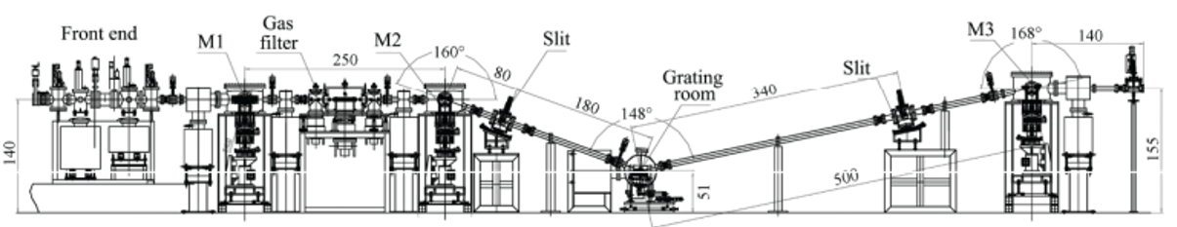
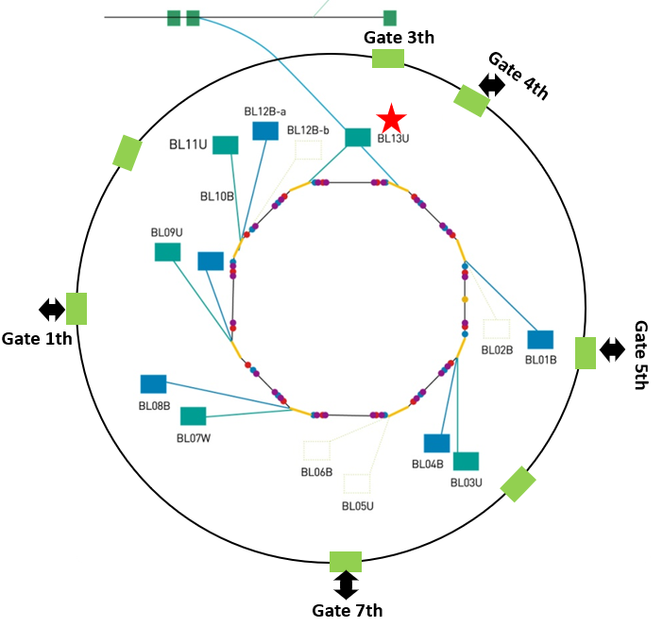
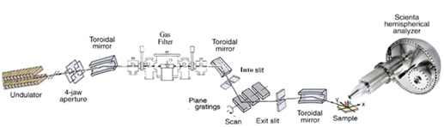
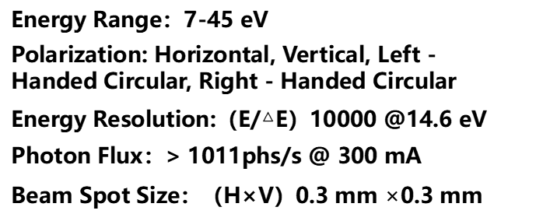
Beamline Layout
BL01B：Infrared Spectroscopy and Microscopy Imaging Beamline
BL03U: Combustion Beamline
BL04B：Mass Spectrometer Endstation
BL07W: Soft X - Ray Imaging Beamline
BL08B: Spectral Radiation Standards and Metrology Beamline
BL09U: Atomic and Molecular Physics Beamline
BL10B: Photoelectron Spectroscopy Beamline
BL11U: Catalysis and Surface Science Beamline
BL12B-ɑ: Soft X - Ray Magnetic Circular Dichroism Beamline
BL12B-ɓ: soft X-ray absorption spectra
BL13U: Angle-resolved photoemission spectroscopy(ARPES) Beamline
Energy Range：7-45 eV
Polarization: Horizontal, Vertical, Left - Handed Circular, Right - Handed Circular
Energy Resolution:（E/△E）10000 @14.6 eV
Photon Flux：> 1011phs/s @ 300 mA
Beam Spot Size：（H×V）0.3 mm $×$0.3 mm
"meV Energy-Resolved Vacuum Ultraviolet Beamline of Hefei Light Source" by Zhu Suyun, Zhang Guobin, et al., published in Volume 35 of Nuclear Techniques, pages 241 - 244 (2012).

Slide 4
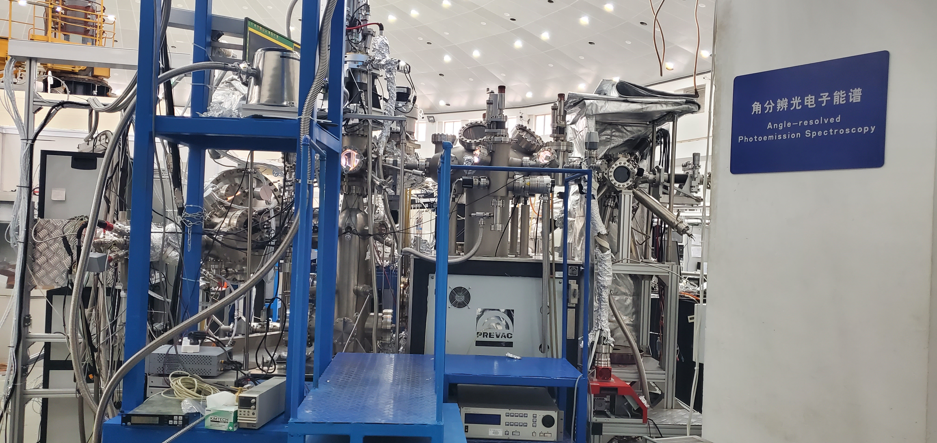
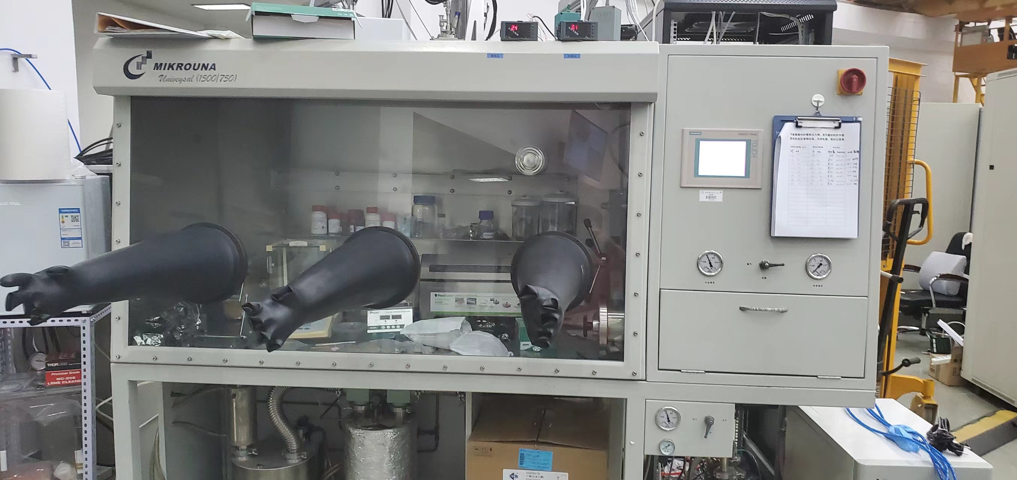
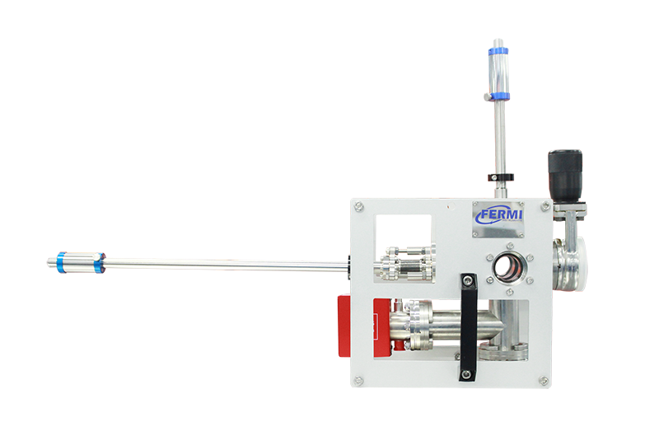
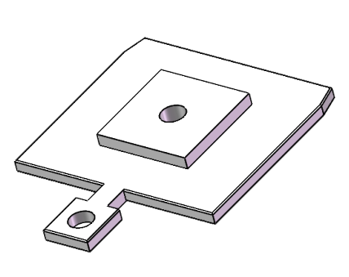
Experimental Station Layout
Transfer
Chamber
Loading Chamber
/Suitcase Connection Chamber
Preparation Chamber
DA30L
Analyzer
Sample Processing Chamber
VLEED
Spin Detector
Sample Storage Chamber
Analysis
Chamber
Glove Box
Analysis Chamber: Angle-resolved Photoemission Spectroscopy, Spin-resolved Photoemission Spectroscopy
Preparation Chamber: Alkali Metal Evaporation, LEED Surface Morphology Characterization
Sample Processing Chamber: In-situ Thin Film Growth, Sample Surface Argon Etching and Annealing
Suitcase: Ultra-high Vacuum Sample Transfer Testing
Glove Box: Preparation of Samples of Air-sensitive Materials
Standard Flag-type Sample Holder
Suitcase
Transfer Chamber

Slide 5
Table of Contents
01
02
03
04
Introduction to the Beamline
Experimental
Methods
Research Examples
Experiment Application

Slide 6
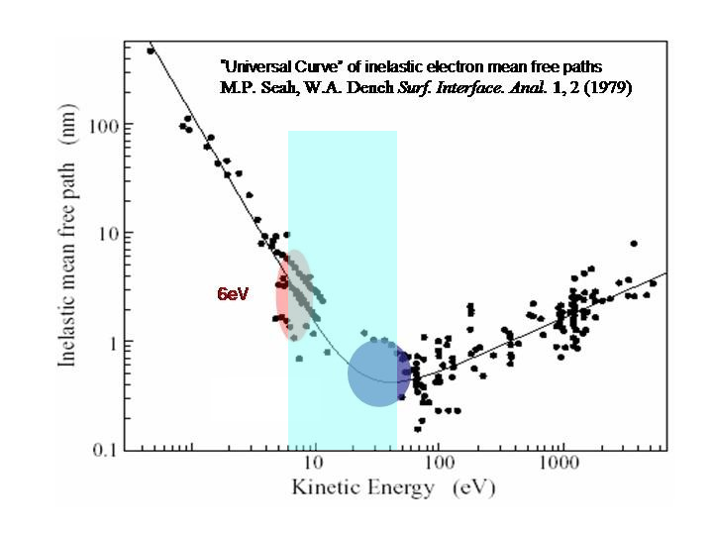
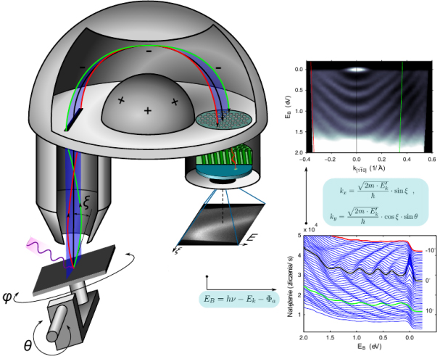
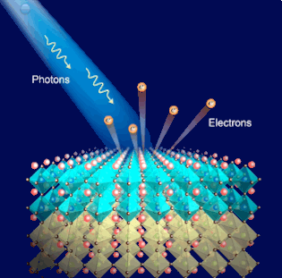
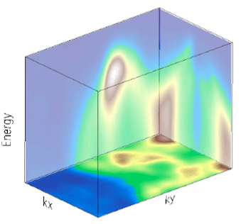
Experimental Methods：
Angle-Resolved Photoemission Spectroscopy (ARPES)
Principle: Based on the photoelectric effect
Sample Requirements: Single-crystal samples (minimum size 0.3mm), electrically conductive (small-band-gap semiconductors are also acceptable), and without strong magnetism.
Features: High surface sensitivity, suitable for inorganic samples, and requires an ultra-high-vacuum environment.

Slide 7
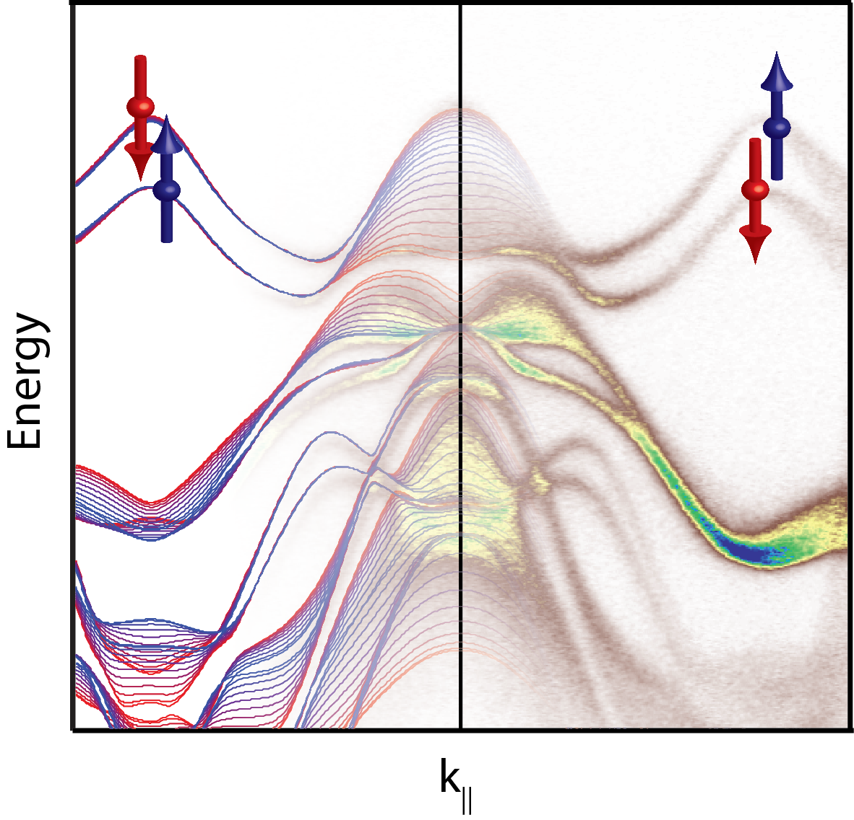
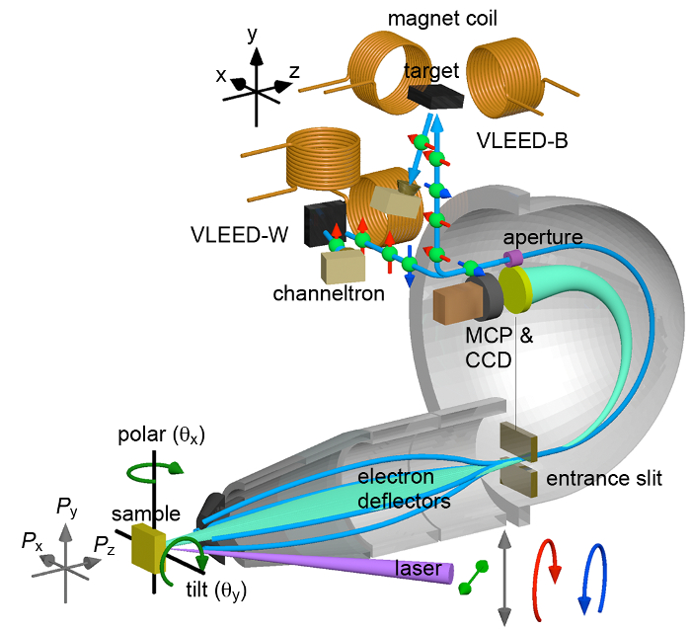
Experimental Methods：
Spin-Resolved Photoemission Spectroscopy
Principle: Utilizes the exchange interaction between spin-polarized electrons and ferromagnetic thin films. Measures the reflectivity of electrons on ferromagnetic targets magnetized in the +z and -z directions respectively, and determines the spin of incident electrons in the z - direction by measuring the relative difference between the two reflectivities.

Slide 8
Table of Contents
01
02
03
04
Introduction to the Beamline
Experimental
Methods
Research Examples
Experiment Application

Slide 9
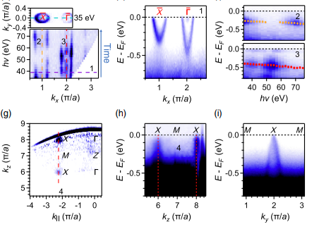
Kaustuv Manna
Direct Acquisition of Electronic Structure
For the (001) cleavage plane of EuB₆, different surface states were observed on the Eu and B termination surfaces. The B termination surface shows spin - splitting and band inversion during the ferromagnetic transition, forming a magnetic topological semimetal state with broken time - reversal symmetry.
Shun-Ye Gao & Sheng Xu et al. Phys. Rev. X 2021, 11, 021016

Slide 10
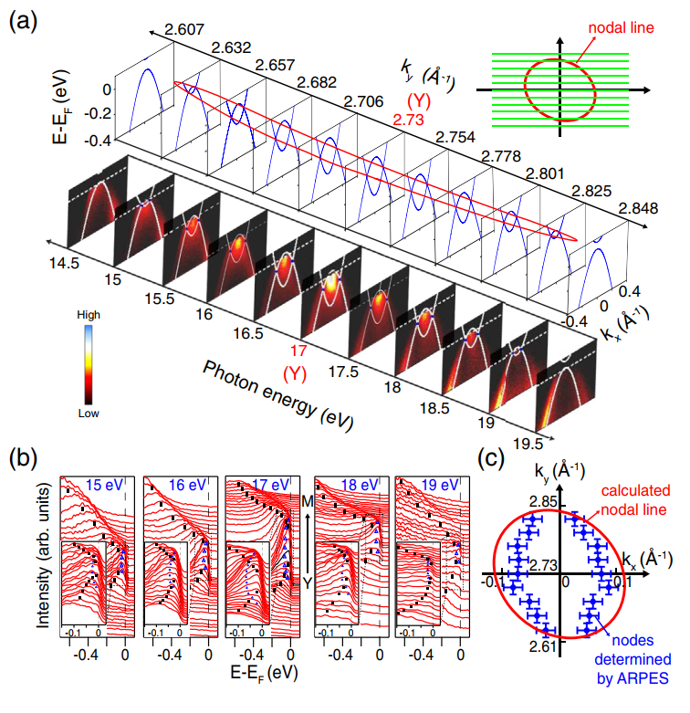
Variable Photon Energy
By changing the photon energy, the nodal line topological electronic structure near the Fermi level near the Brillouin zone Γ point in SrAs₃ material is directly observed under low energy photons ( 10-20 eV ).
Y. K. Song & G. W. Wang et al. Phys. Rev. L 2020, 124,056402

Slide 11
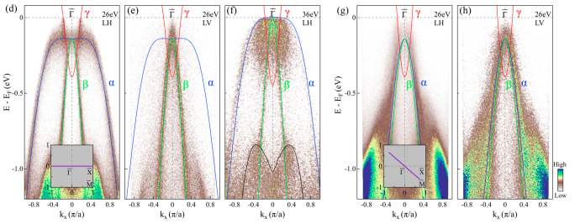
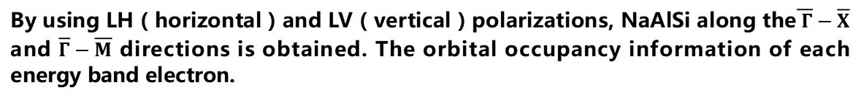
Variable Polarization
By using LH ( horizontal ) and LV ( vertical ) polarizations, NaAlSi along the$\overline{ Γ}−\overline{Χ}$ and $\overline{Γ}−\overline{Μ}$ directions is obtained. The orbital occupancy information of each energy band electron.
Chunyao Song & Lei Jin et al. Phys. Rev. B 2022, 105, L161104

Slide 12
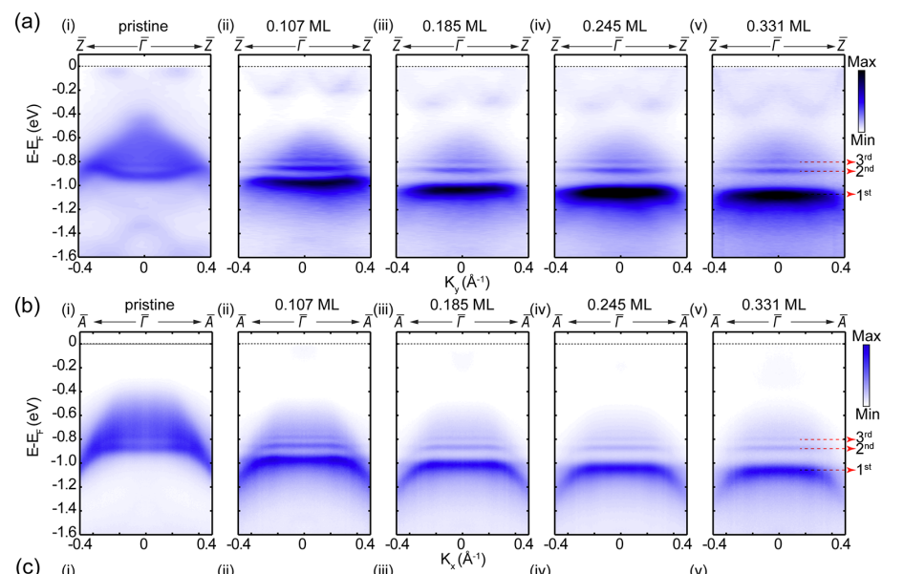
In - situ Alkali Metal Evaporation
By surface evaporation of K on the Nb₂SiTe₄ sample, in addition to seeing more conduction band information, obvious quantum well states are also observed.
Jing Zhang & Zhilong Yang et al. ACS Nano 2021, 15,15850−15857

Slide 13
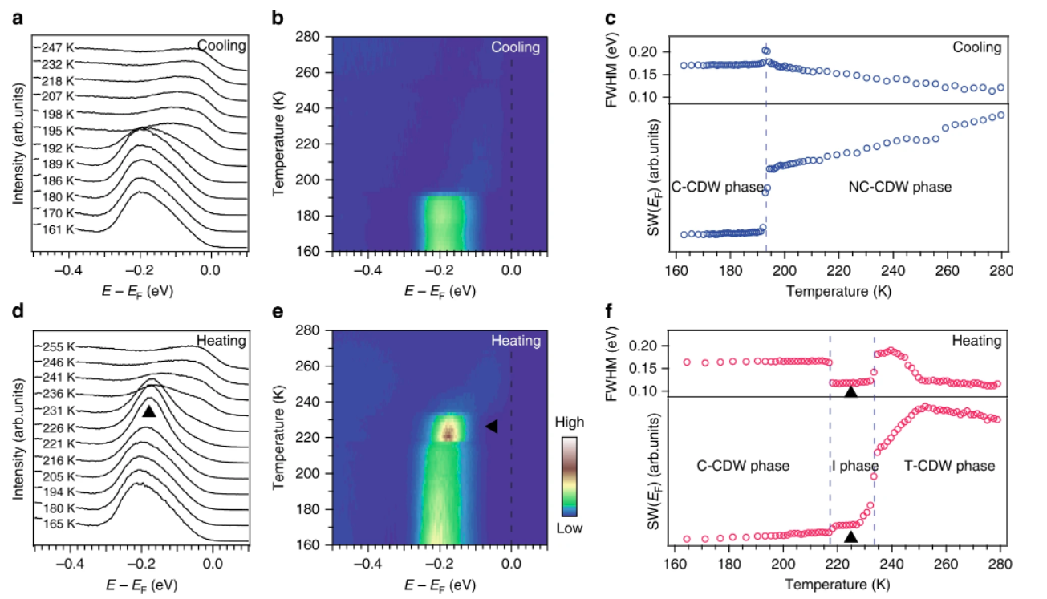
Variable-Temperature Experiments
A previously unobserved insulating intermediate state ( I state ) was found in a small temperature window ( 217K-233K ) near the 1T-TaS₂ phase transition through continuous and precise temperature experiments.
Y. D. Wang & W. L. Yao et al. Nat. Comm. 2020, 11, 4215

Slide 14
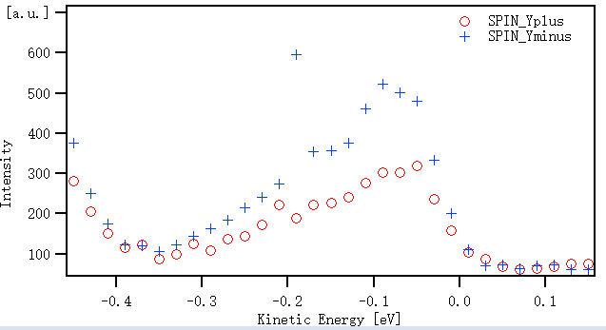
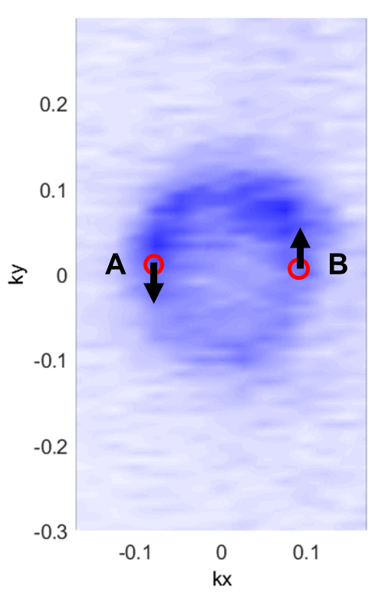
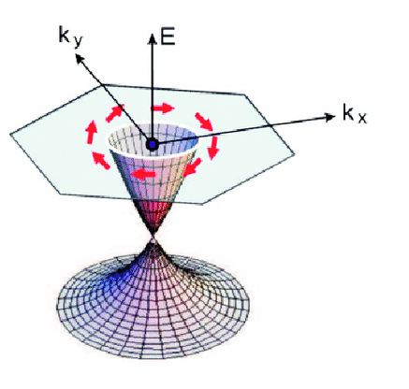
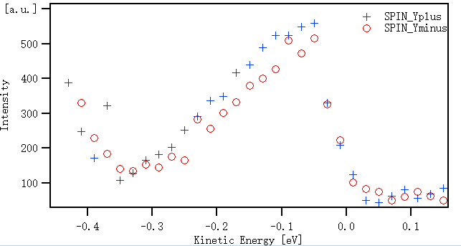
Spin Information Detection
Measured spin texture data of Bi₂Se₃ single crystal

Slide 15
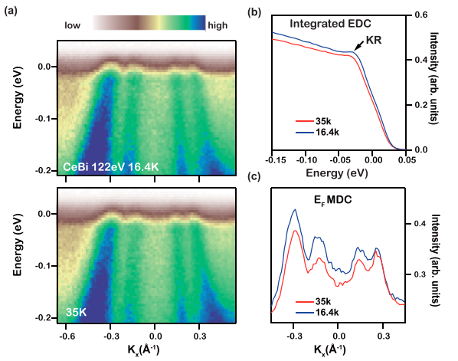
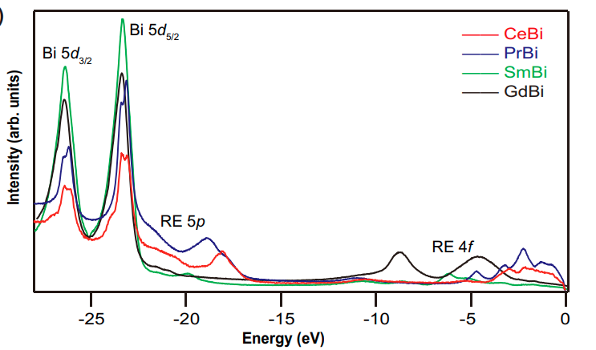
Element Resolution and Chemical Environment Changes
The UPS characteristic peaks of REBi ( RE = Ce, Pr, Sm, Gd ) compounds gradually shift to the core level with the increase of the effective mass of RE element. For CeBi, as the temperature decreases, the Ce 5d band density of states also moves to the core level, causing the expansion of the Fermi pocket.
Peng Li & Zhongzheng Wu et al. Phys. Rev. B 2018, 98, 085103
Peng Li & Zhongzheng Wu et al. Phys. Rev. B 2019, 00, 005100

Slide 16
Table of Contents
01
02
03
04
Introduction to the Beamline
Experimental
Methods
Research Examples
Experiment Application

Slide 17

Experiment Application
Users need to log in to the Shared Service Platform of Major Scientific and Technological Infrastructures of the Chinese Academy of Science （ https：//lssf.cas.cn ）， and register an account.
Submit a research project application (non - working personnel are not eligible to apply).
The Hefei Light Source accepts user project applications throughout the year and reviews them quarterly.
For details of the beam time application and usage process, please visit:： http://www.nsrl.ustc.edu.cn/2016/0425/c10980a124134/page.htm
Hefei Light Source Official Account：

Slide 18
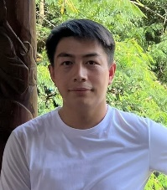


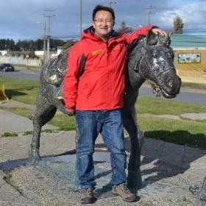
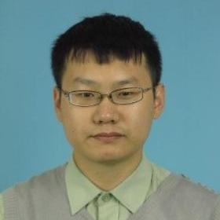
Contact Information
Zhanfeng Liu
Post-Doctoral Researcher
Beamline shift supervisor
0551-6362060
lzfeng23@ustc.edu.cn
Zhe Sun
professor
Beamline Scientists
0551-63601983
zsun@ustc.edu.cn
Guobin Zhang
Researcher
Beamline Scientists
0551-63602204
gbzhang@ustc.edu.cn
Yi Liu
Senior Engineer
Maintenance Engineer
0551-63602060
liuyi@ustc.edu.cn
Shengtao Cui
Senior Engineer
Maintenance Engineer
0551-63602060
shengtaocui@ustc.edu.cn
Adequate early communication is conducive to the smooth progress of the subject.

Slide 19
Contact Information for Other Beamlines
Infrared Spectroscopy and Microscopy Imaging Beamline
contact：Zeming Qi
E-mail：zmqi@ustc.edu.cn
Atomic and Molecular Physics Beamline
contact：Zhandong Wang
E-mail：zhdwang@ustc.edu.cn
Combustion Beamline：
contact：Jiuzhong Yang
E-mail：jzyang@ustc.edu.cn
Photoelectron Spectroscopy Beamline
contact：Haibin Pan
E-mail：hbpan@ustc.edu.cn
Mass Spectrometry Beamline
contact：Yang Pan
E-mail：panyang@ustc.edu.cn
Catalysis and Surface Science Beamline
contact： Junfa Zhu
E-mail：jfzhu@ustc.edu.cn
Soft X-Ray Imaging Beamline
contact：Gang Liu
E-mail：liugang@ustc.edu.cn
Soft X - Ray Magnetic Circular Dichroism Beamlin econtact：Wensheng Yan
E-mail：ywsh2000@ustc.edu.cn
Angle-Resolved Photoemission Spectroscopy
contact：Zhe Sun
E-mail：zsun@ustc.edu.cn
Spectral Radiation Standards and Metrology Beamline
contact：Hongjun Zhou
E-mail：hjzhou@ustc.edu.cn
Contact Person of the User Office:
Jiang Fang
TEL：0551-63602018（24h）
E-mail：jiangf@ustc.edu.cn
Security Office：0551-63602020
Emergency Contact for Radiation Protection：
0551-63602026
Reservation Phone Number for the West Area Expert Building: 0551-63602880

Slide 20


Thanks
USTC
NSRL

