Slide 1




肥
合
HEFEI
LIGHT SOURCE
光
源
XMCD Beamline
OF EXPERIMENTAL STATION
HEFEILIGHT SOURCE INTRODUCTION

Slide 2


目录
CATALOG
01
02
03
04
Introduction
Methods
Scientific cases
Beamtime application

Slide 3

Beamline Layout
线站在环厅③号门位置
BL12B-b分线
——两分支线+三站
BL12B-a分线
BL12B-b分线
XAS spectra
In-situ XAS
BL12B-a分线
Vector-XMCD
beamline | Beam energy(eV) | resolution(E/⊿E) | Flux | beamsize
BL12B-a | 100-1000 | 2400@244eV | 2x10⁹ phs/s @244eV | 1x0.5mm²
BL12B-b | 50-1000 | 2300@244eV | 1.8x10¹⁰ phs/s @244eV | 1x0.5mm²

Slide 4
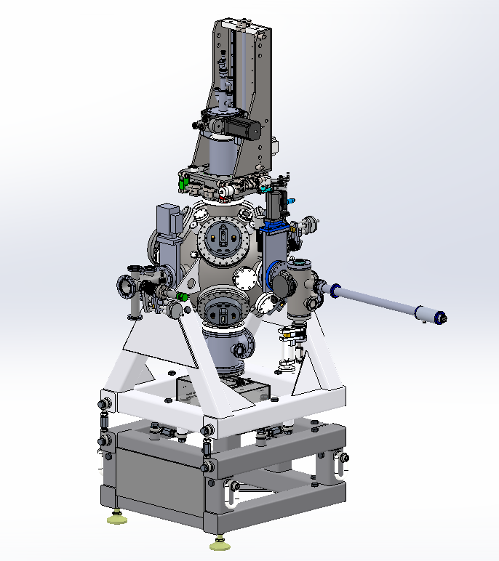
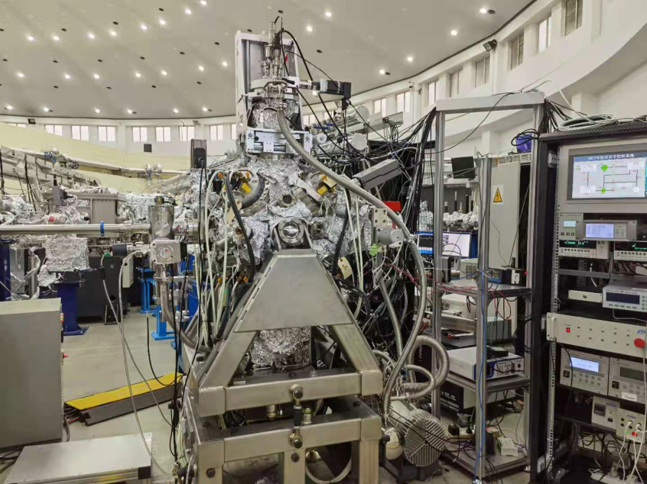
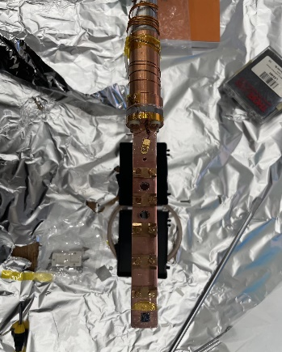
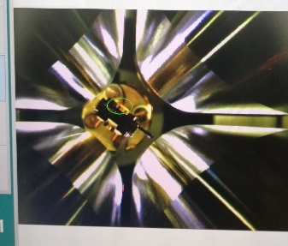
Beamline Layout
Vector Magnet Station
Mode：TEY、Transmission
Chamber：XAS，XMCD, XMLD
Temperature：10K-300K
Magnetic Field：0-0.8T
Vertor-magnet
Sample holder

Slide 5
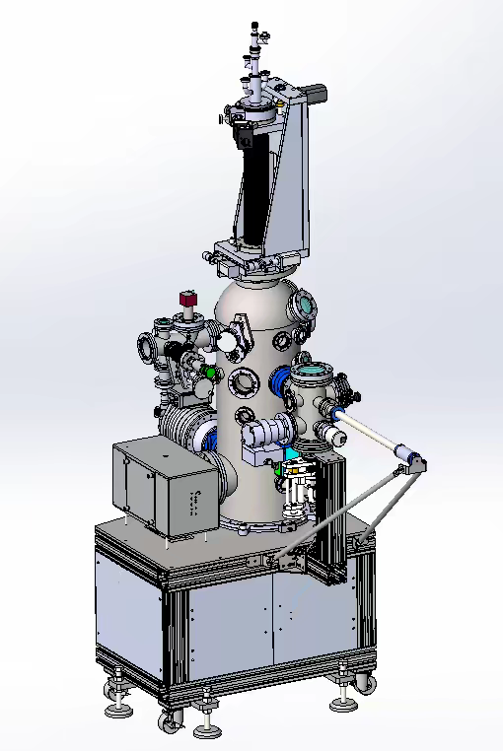
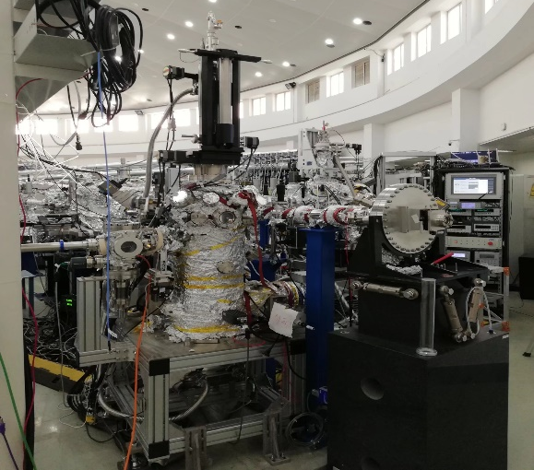
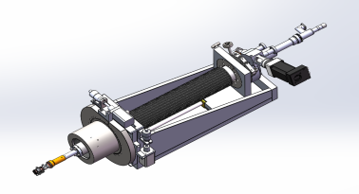
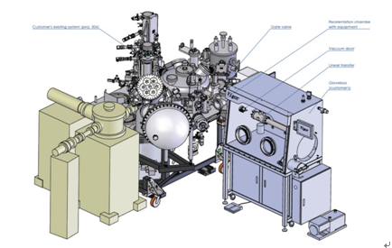
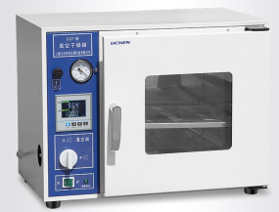
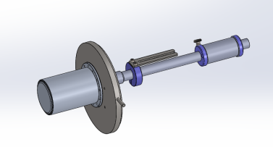
Beamline Layout
XAS station
Mode：TEY/TFY/PFY/XEOL
Chamber： XAS，XEOL
Temperature：90K-300K
Sample transfer：in-situ
Transfer

Slide 6
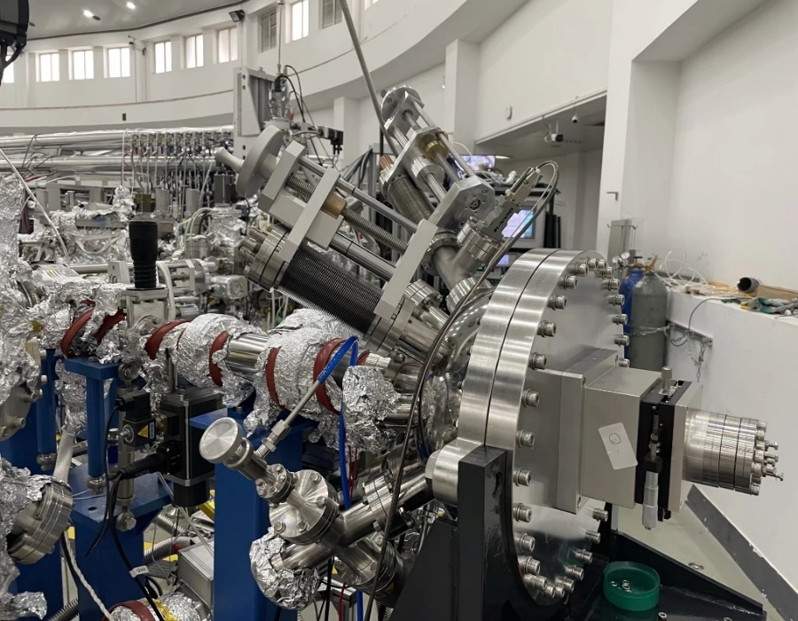
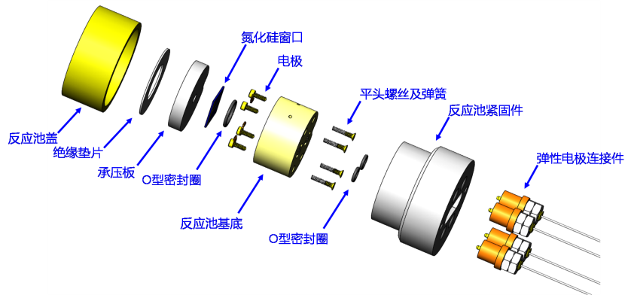
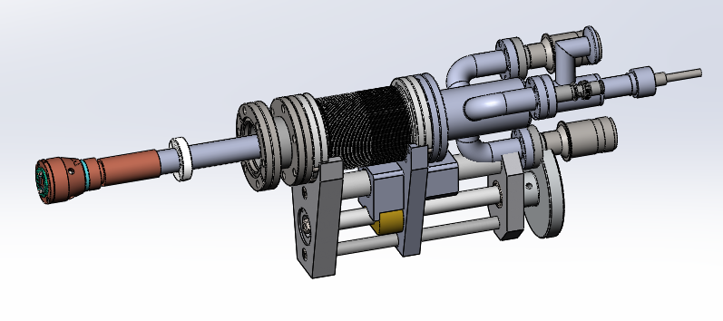
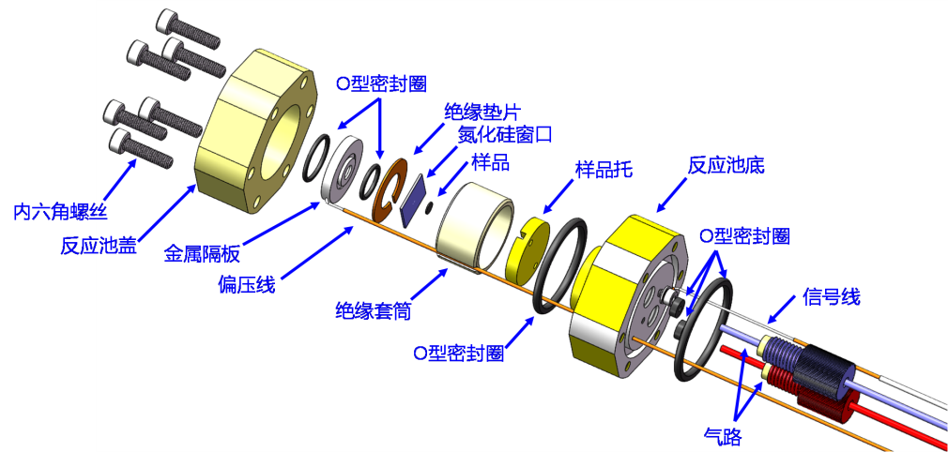
In-situ Dynamic Liquid-phase Reaction Cell
Beamline Layout
In-situ XAS
In-situ Dynamic Liquid-phase Reaction Cell
Sample holder
In-situ Dynamic Liquid-phase Reaction Cell
Mode：TEY/PFY

Slide 7
目录
CATALOG
01
02
03
04
Introduction
Methods
Scientific cases
Beamtime application

Slide 8


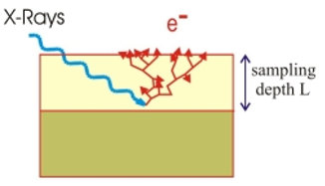
Experimental Method: X-ray Absorption Spectroscopy(XAS)
Incidence:
Tunable photon
Detection:
Emitted electron
Detection:
Emitted photon
2s
2s
2s
1s
1s
1s
2p
2p
2p
photon
Electron Yield
Signal：Auger electrons, photoelectrons, and secondary electrons
Detection Depth：1 ~ 8 nm
Fluorescence Yield
Signal ：Fluorescent Photons
Detection Depth：100 nm ~ several um
X-rays
Advantage: Element-specific resolution, enabling probing of the local atomic structure and electronic structure of absorbing atoms.

Slide 9
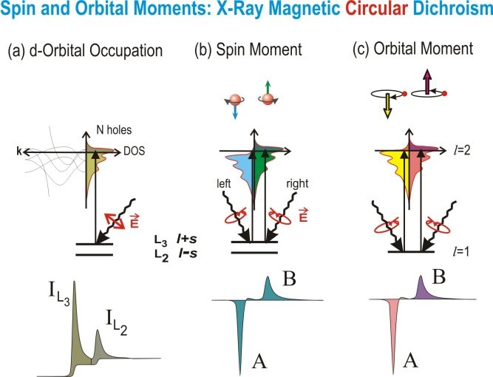
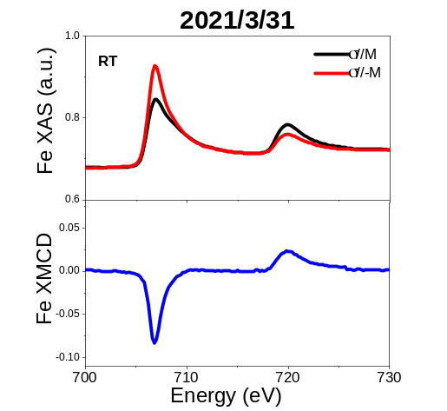
Experimental Method:
X-ray Magnetic Circular Dichroism
Spin and orbital moment: XMCD theory
Electron Yield
Signal：Auger electrons, photoelectrons, and secondary electrons
Detection Depth：1 ~ 8 nm
Transimission Mode
Luminiscence yield Mode
轨道占据
自旋磁矩
轨道磁矩
Advantages:
​1: Quantitative separation of electron spin magnetic moment and orbital magnetic moment​
​2: Element-specific resolution​ (distinctly identifies contributions of different elements to macroscopic magnetism)
​3: High surface sensitivity​ (electron yield mode)

Slide 10
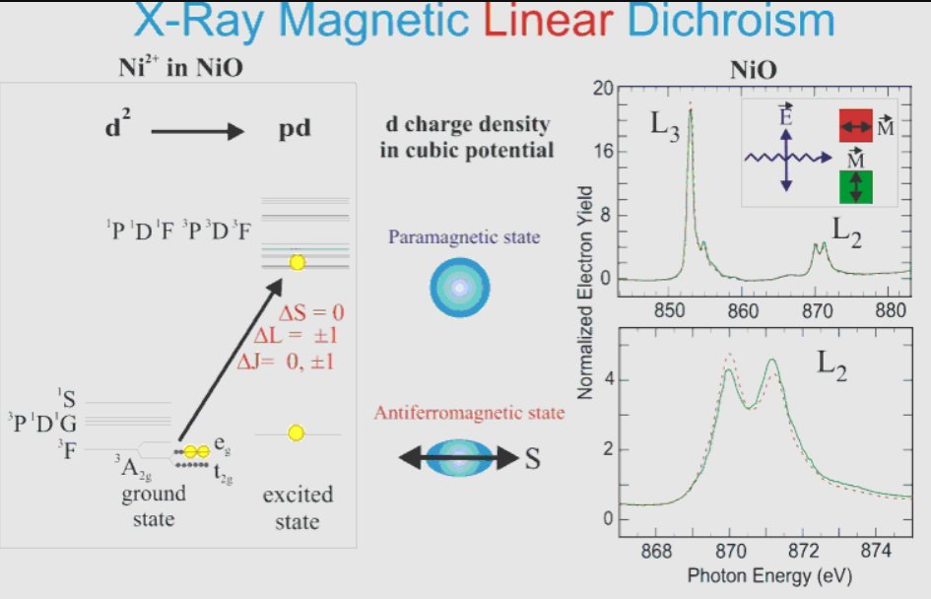
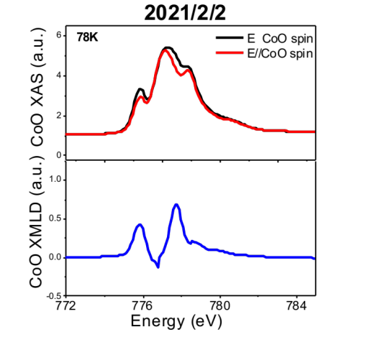
Experimental Method:
X-ray Magnetic Linear Dichroism
XMLD theory
Electron Yield
Signal：Auger electrons, photoelectrons, and secondary electrons
Detection Depth：1 ~ 8 nm
Transimission Mode
Luminiscence yield Mode
Advantages:
​Enables measurement of crystal field effects via X-ray Linear Dichroism (XLD)​​
​Determines antiferromagnetic spin orientation using XMLD – one of the few direct methods for probing antiferromagnetic information​
​High surface sensitivity (electron yield mode)​

Slide 11
目录
CATALOG
01
02
03
04
Introduction
Methods
Scientific cases
Beamtime application

Slide 12
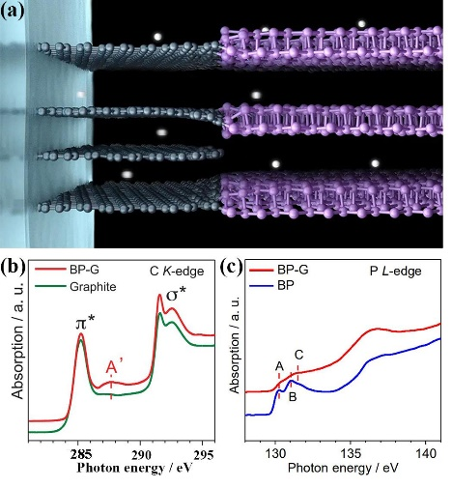
Absorption spectroscopy is an effective tool for probing microscopic structures
Soft X-ray absorption spectroscopy probes the C K-edge and P L-edge in battery materials, revealing atomic coordination environments and electronic structures. It elucidates energy storage mechanisms, providing a powerful foundational tool for advancing from material observation science to material control science.
Science 2020, 370, 192-197

Slide 13

Absorption Spectroscopy Deciphers Coordination Environments and Electronic Structures
Soft X-ray absorption spectroscopy probes the N K-edge in energy catalytic materials, resolving atomic coordination environments and electronic structures. Integrated with complementary characterization data, it elucidates catalytic reaction mechanisms.
Nature Nanotechnol. 2020, 16, 325-330

Slide 14
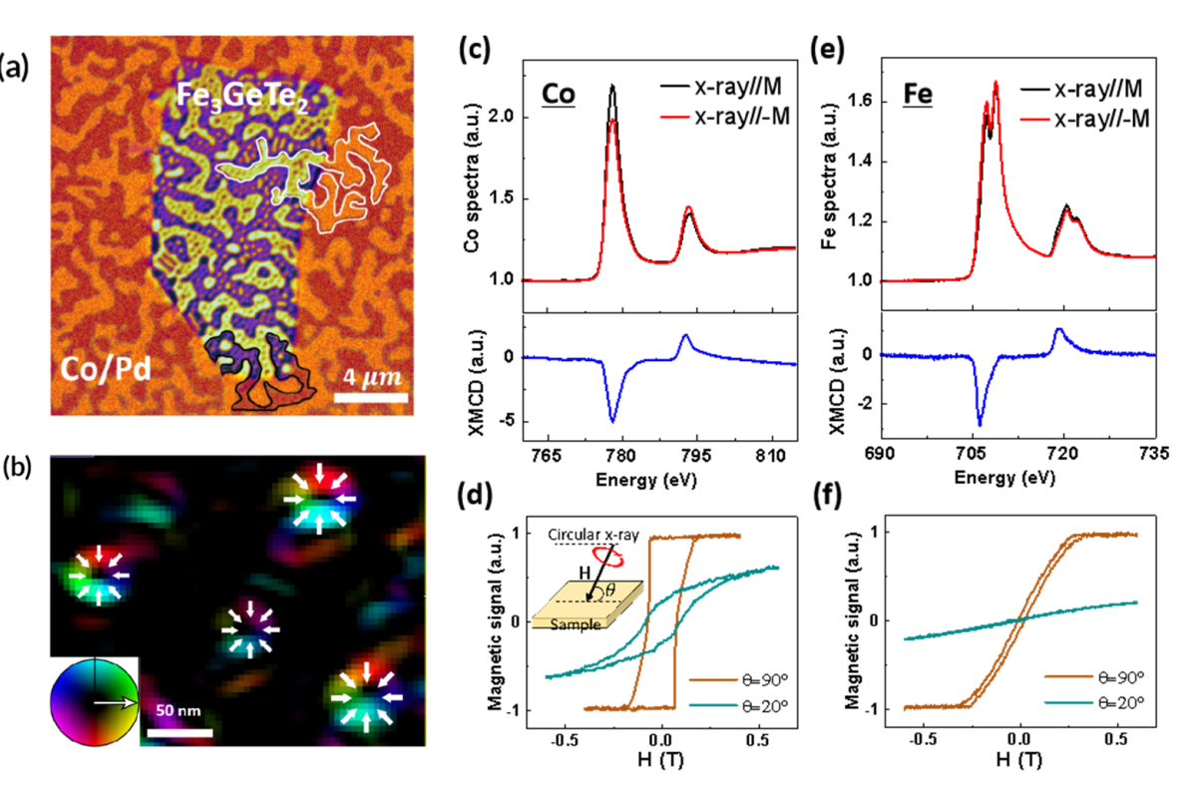
XMCD Technique Probes Magnetic Properties
XMCD plays a pivotal role in 2D magnetic materials research, enabling the detection of: Magnetic strength variation across ferromagnetic layers; Saturation field magnitudes; Easy magnetization axes; Orbital magnetic moments; Spin magnetic moments。
Sci. Adv. 6, eabb5157 (2020)

Slide 15
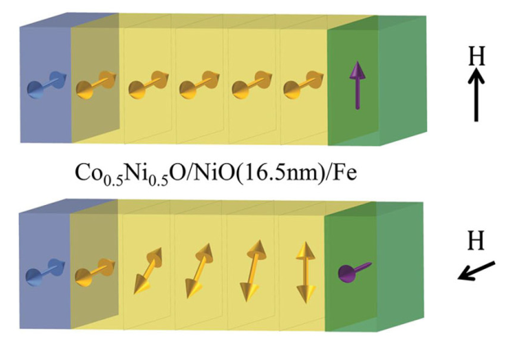
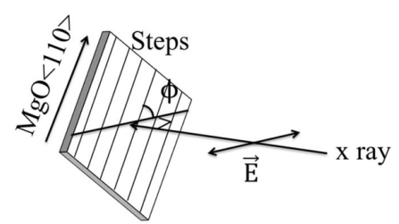
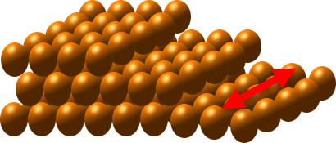
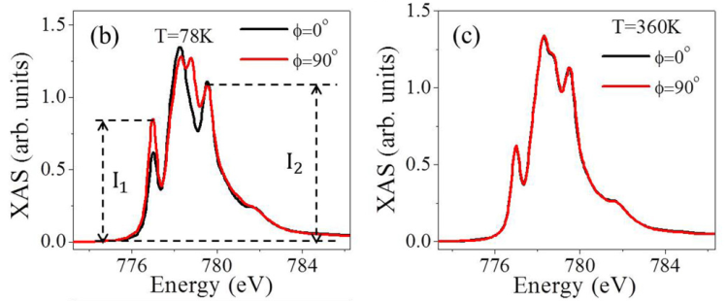
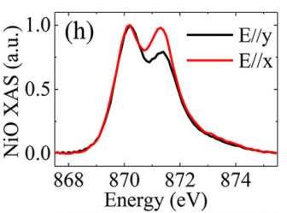
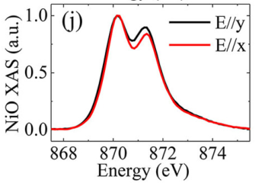
XMLD Technique Probes Antiferromagnetic Spin Orientation
Utilizing interfacial coupling between ferromagnetic (FM) and antiferromagnetic (AFM) layers, the application of a magnetic field rotates the FM layer's magnetic moment, thereby engineering single-domain or spring-type domain wall configurations within the AFM layer
PRB 91,104424 (2015); Phys. Rev. Mater. 3,114415 (2019)

Slide 16
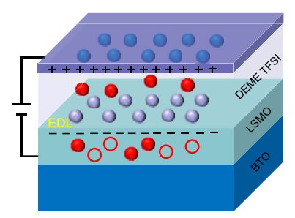
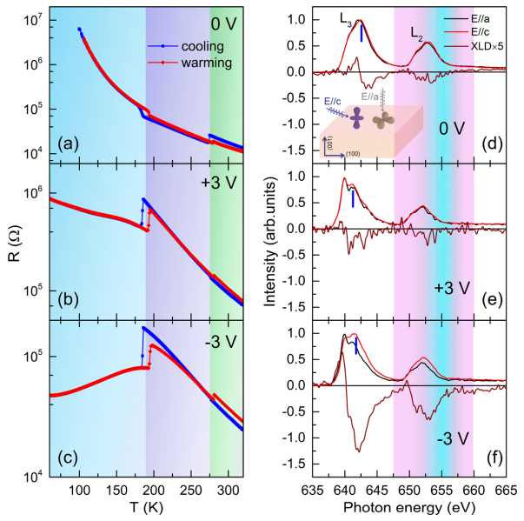
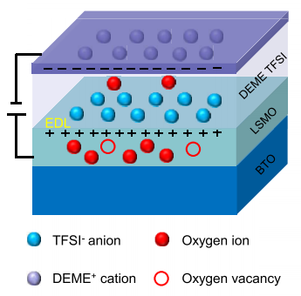
Combined XAS and XLD Spectroscopy for Resolving Crystal Field Effects
X-ray Absorption Spectroscopy (XAS) plays a critical role in analyzing element valence states in ferroelectric materials, while X-ray Linear Dichroism (XLD) effectively determines crystal field variations and probes lattice distortions.
ACS Appl. Mater. Interfaces 12, 43257 (2020)

Slide 17
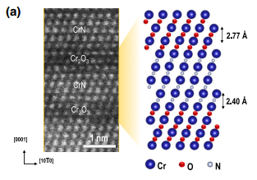
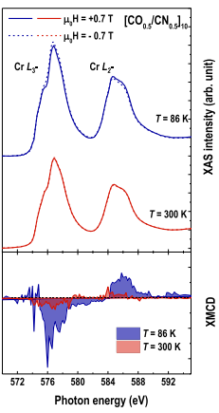

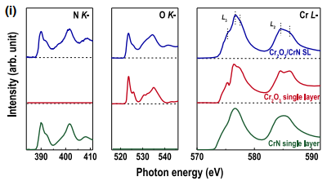
Combined XAS, XMCD, and XLD Techniques for Superlattice Characterization
The combined application of XAS, XMCD, and XLD techniques provides comprehensive characterization of superlattice samples, resolving: Elemental valence states and charge transfer; Magnetic strength and ferromagnetic-antiferromagnetic phase transitions; Crystal field distortions .
Q. Jin et al., PRL 128, 017202 (2022)

Slide 18
目录
CATALOG
01
02
03
04
Introduction
Methods
Scientific cases
Beamtime application

Slide 19

User Guide for NSRL (Hefei Light Source) Facility Access
Registration @ https：//lssf.cas.cn
Proposal Submission
Proposal Review
Beamtime Application & Usage, Detailed procedures: http://www.nsrl.ustc.edu.cn/2016/0425/c10980a124134/page.htm
Follow updates via：

Slide 20


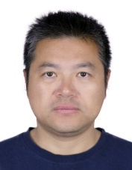
Contact
Yan Wensheng
0551-63602131
ywsh2000@ustc.edu.cn
Zhang Wenhua
0551-63601992
zhangwh@ustc.edu.cn
Chen Kai
18214752842
kaichen2021@ustc.edu.cn

Slide 21




Contact
Li Qian
0551-63607465 liqian89@ustc.edu.cn
Wang Chao
0551-63602060
chaowng@ustc.edu.cn
Chen Shuangming
0551-63607731
csmp@ustc.edu.cn
Hu Fengchun
0551-63602060 fchu@ustc.edu.cn

Slide 22
联系我们
红外谱学和显微成像光束线站：
联系人：戚泽明
E-mail：zmqi@ustc.edu.cn
原子分子物理光束线站
联系人：王占东
E-mail：zhdwang@ustc.edu.cn
燃烧光束线站
联系人：杨玖重
E-mail：jzyang@ustc.edu.cn
光电子能谱光束线站
联系人：潘海斌
E-mail：hbpan@ustc.edu.cn
质谱光束线站
联系人：潘 洋
E-mail：panyang@ustc.edu.cn
催化与表面科学光束线站
联系人：朱俊发
E-mail：jfzhu@ustc.edu.cn
软X射线成像光束线站
联系人：刘 刚
E-mail：liugang@ustc.edu.cn
软X射线磁性圆二色（XMCD）光束线站
联系人：闫文盛
E-mail：ywsh2000@ustc.edu.cn
角分辨光电子能谱（ARPES）光束线站
联系人：孙 喆
E-mail：zsun@ustc.edu.cn
光谱辐射标准和计量光束线站
联系人：周洪军
E-mail：hjzhou@ustc.edu.cn
用户办联系人： 江 芳
电 话：0551-63602018（24h）
E-mail：jiangf@ustc.edu.cn
保卫室：0551-63602020
辐射防护紧急联系：0551-63602026
西区专家楼订房电话：0551-63602880

Slide 23


谢谢
中国科技大学
国家同步辐射实验室

