Slide 1




肥
合
HEFEI
LIGHT SOURCE
光
源
原子与分子物理线站
OF EXPERIMENTAL STATION
HEFEILIGHT SOURCE INTRODUCTION

Slide 2


目录
CATALOG
01
02
03
04
Beamline
Methods
Examples
Beamtime

Slide 3

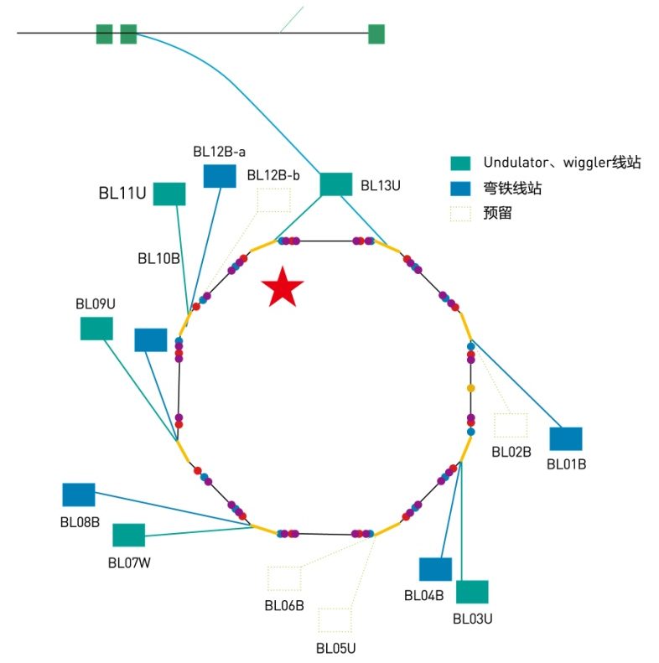
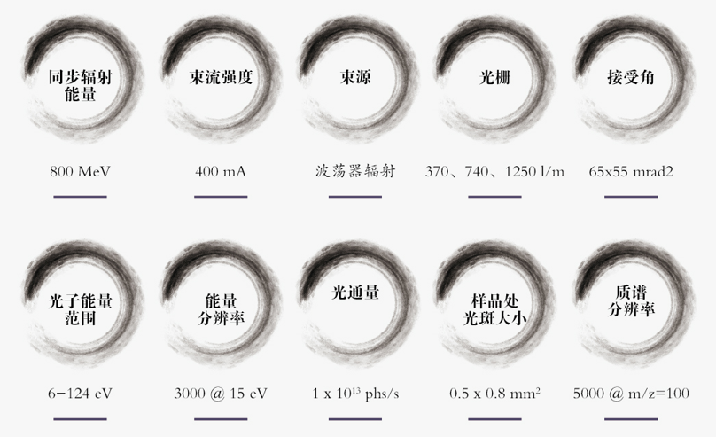
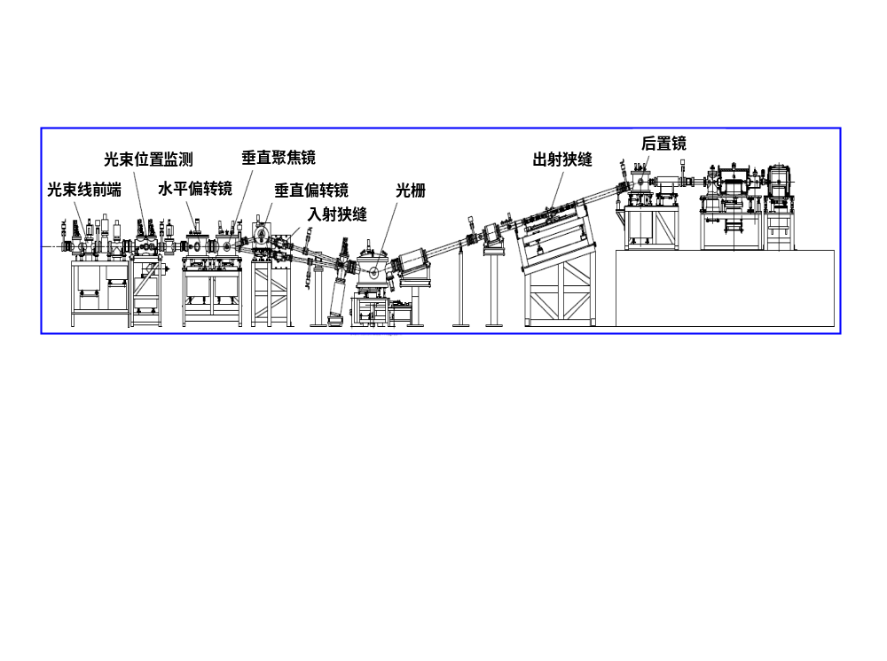
Beamline configuration
Energy
Beam
current
Source
Grating
Acceptance
angle
800 MeV
400 mA
Undulator
370/740/1250 l/m
65x55 mrad²
Entrance 1
Photon
Energy
Resolution
Photon
Flux
Beam
size
Mass Spectral
Resolution
6-124 eV
3000@15 eV
1 x 10¹³ phs/s
0.5 x 0.8 mm²
5000@m/z=100

Slide 4
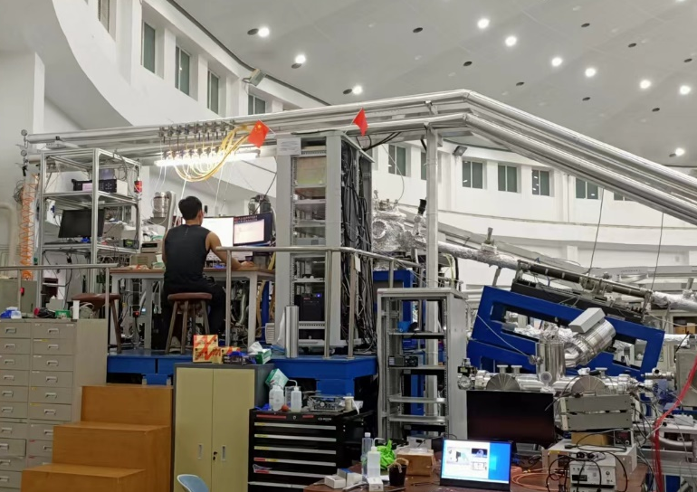
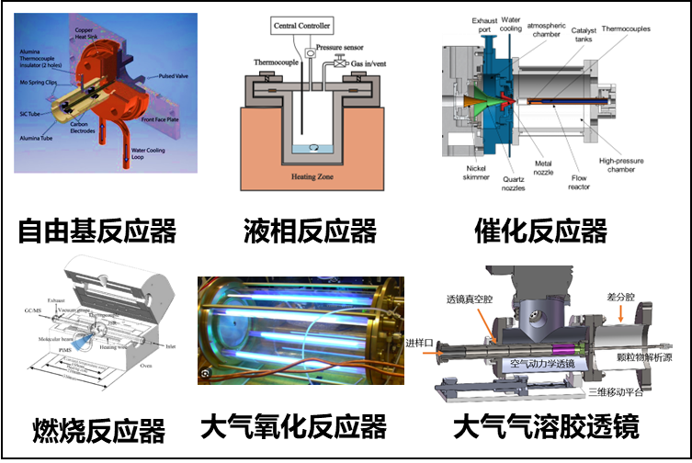
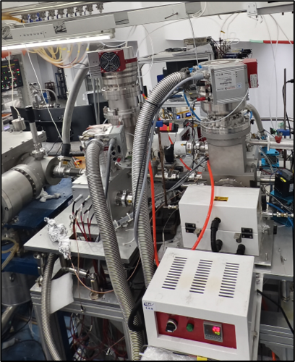
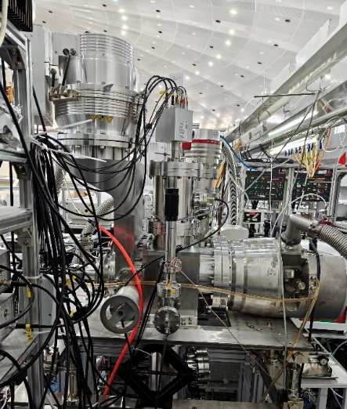
实验站布局图
Chemical reactors
SVUV-PIMS
PEPICO
SVUV-AMS

Slide 5
目录
CATALOG
01
02
03
04
Beamline
Methods
Examples
Beamtime

Slide 6
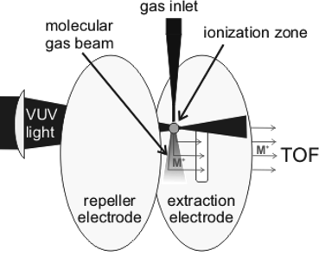
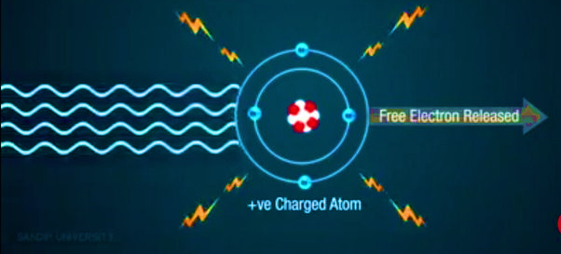
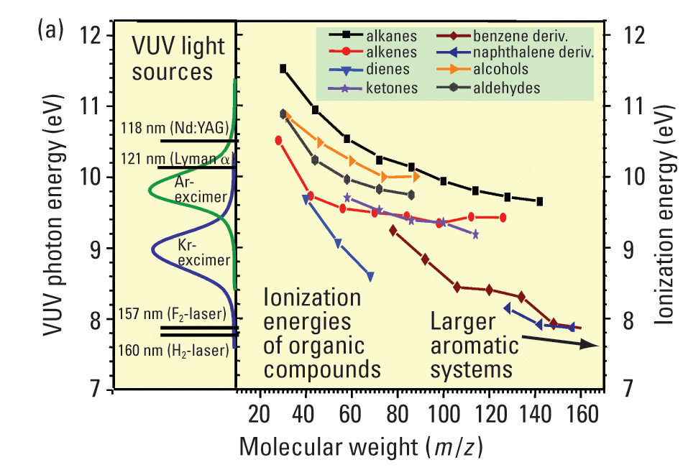
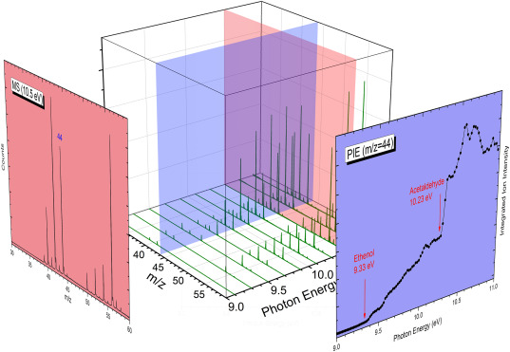
Method 1：Synchrotron VUV photoionization mass spectrometry
Photoionization
Sample
Molecular beam
Ionization zone
Time of flight mass spectrometer
Repulsive
plate
extractor
Energy range covers all organic ionization energies
“Soft” ionization
Universal detection method
Ability to resolve isomers

Slide 7
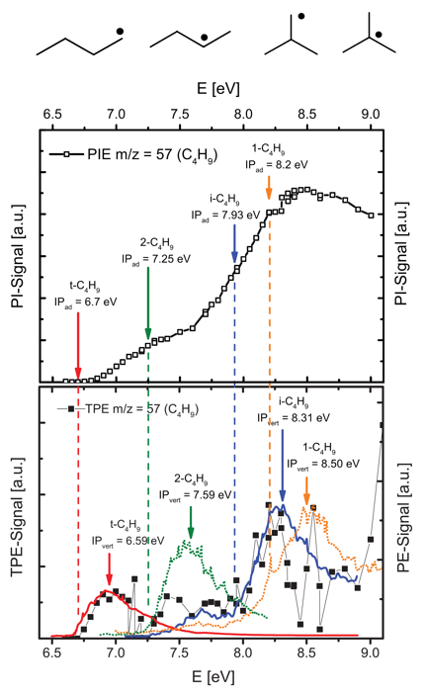
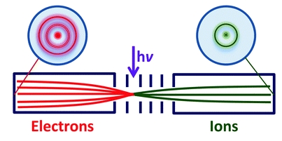
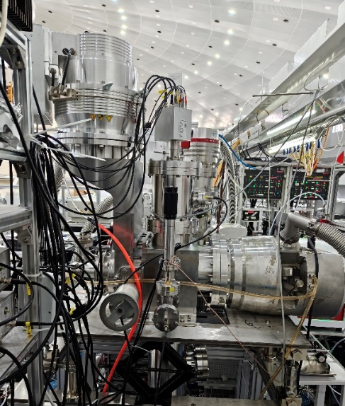
Method 2：Photoelectron-photoion coincidence (PEPICO)
Simultaneous monitoring of ions and electrons in the same ionization event
Better isomer discrimination capability
A powerful tool for studying the extreme ultraviolet photoionization dynamics of photoresists

Slide 8
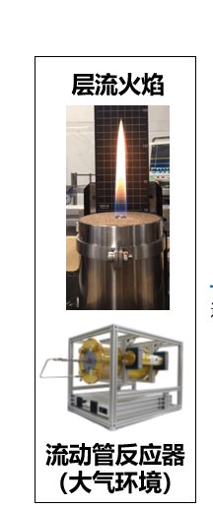
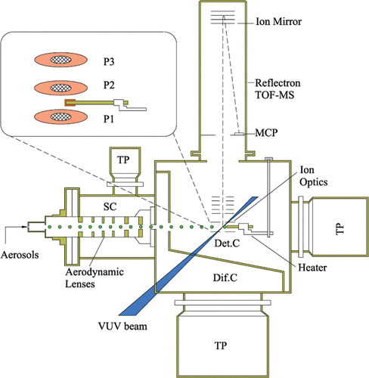
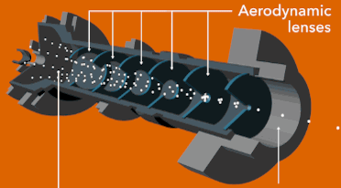
Method 3：Synchrotron Radiation Aerosol Mass Spectrometry
aerodynamic lens
Online monitoring and analysis of aerosol chemical composition
High particle penetration
Fast vaporization of aerosol by hot target
“Soft" ionization to reduce fragmentation
High pressure
Low pressure

Slide 9
目录
CATALOG
01
02
03
04
Beamline
Methods
Examples
Beamtime

Slide 10
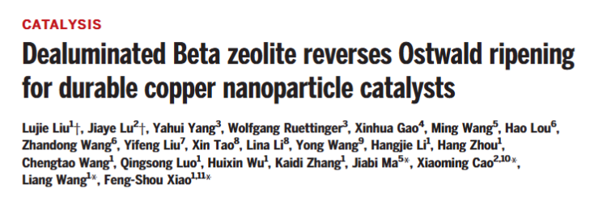
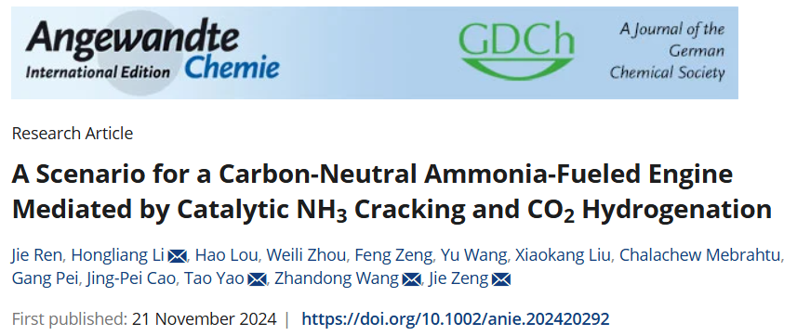
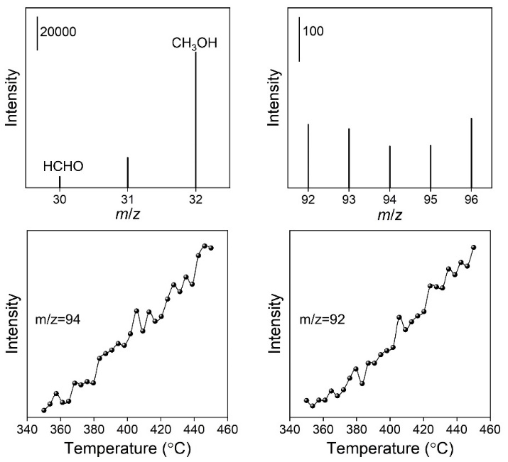
Catalysis and energy conversion
Science, 2024, 383, 94
Xia et al., Angew. Chem. Int. Ed. 2025, 64, e202420779; Wu et al., Angew. Chem. Int. Ed. 2024, 63, e202404983; Zeng et al., Angew. Chem. Int. Ed. 2024, 63, e202404952.

Slide 11
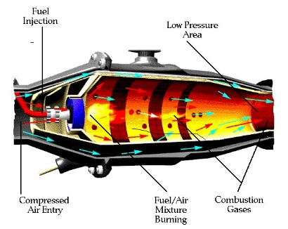
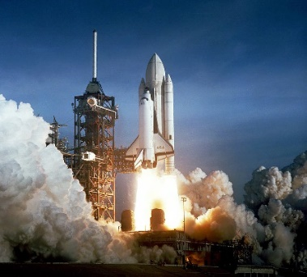
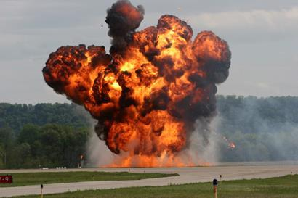

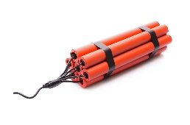
Aerospace propellant、battery thermal runaway
High-resolution and high-sensitivity detection using SVUV-PIMS
In-situ measurement of the microstructure of chemical reaction intermediates and isomer products under complex working conditions
Research on combustion reaction kinetics in the fields of aviation fuel, propellant, explosives, battery thermal runaway, etc.
Aviation fuel
Aerospace propellant
Fire dynamite
Battery thermal runaway
H. Fu, Y. Wang, B. Liu, Z. Wang*, X. Zhang, G. Liu*, Experimental and theoretical study of cyclopropanated fuel exo Tetracyclo[3.3.1.02,4.06,8]nonane pyrolysis in a jet-stirred reactor, Fuel 361, 130702, 2024.
Q. Zhu, B. Liu, Z. Hu, S. Chen, Q. Xu, Z. Wang*, Pyrolysis and kinetic modeling study of TEMED: A potential green propellant, Proc. Combust. Inst., 40, 105426, 2024.
K. Jin, Z. Zhi, L. Wu, Q. Xu, B. Liu, Z. Wang, Z. Tian*, Pyrolysis of norbornadiene: An experimental and kinetic modeling study, Combust. Flame 242, 112155, 2022.
B. Dong, L. Wang, L. Hu, J. Fang, Z. Wang, Exploring the oxidation chemistry of diethyl carbonate in lithium-ion battery thermal runaway using SVUV-PIMS. Proc. Combust. Inst, 2024, 40, 105479.

Slide 12
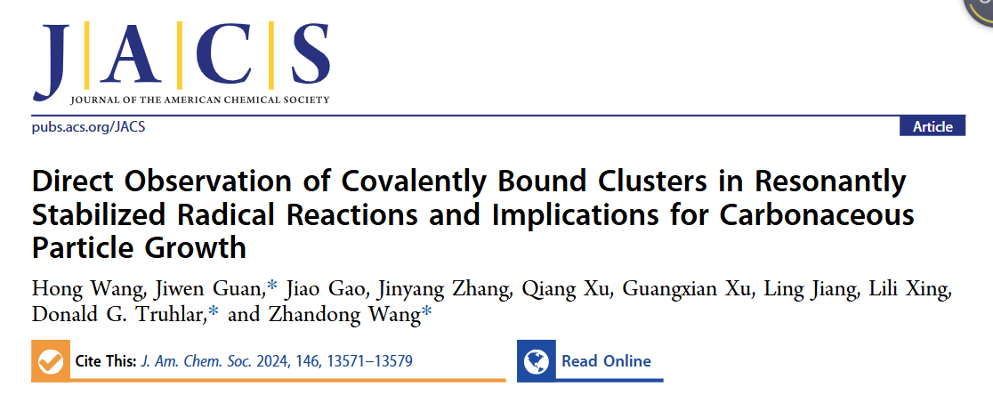

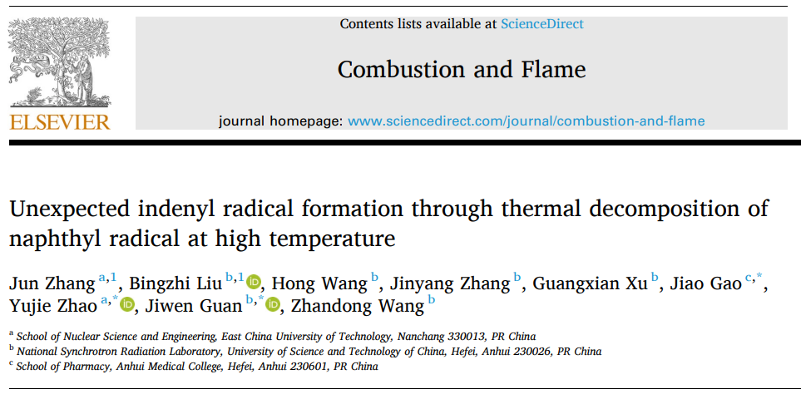
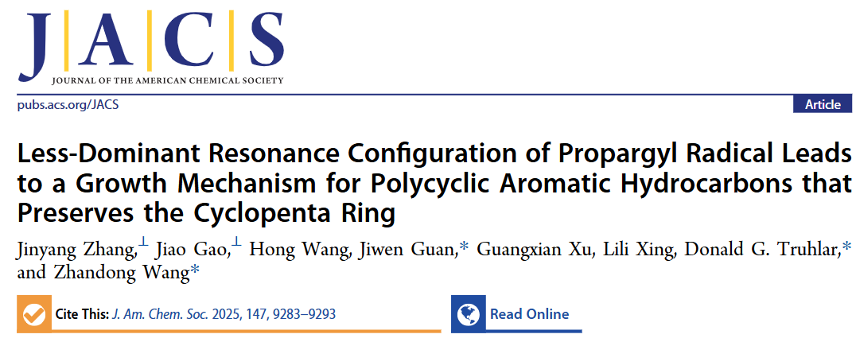
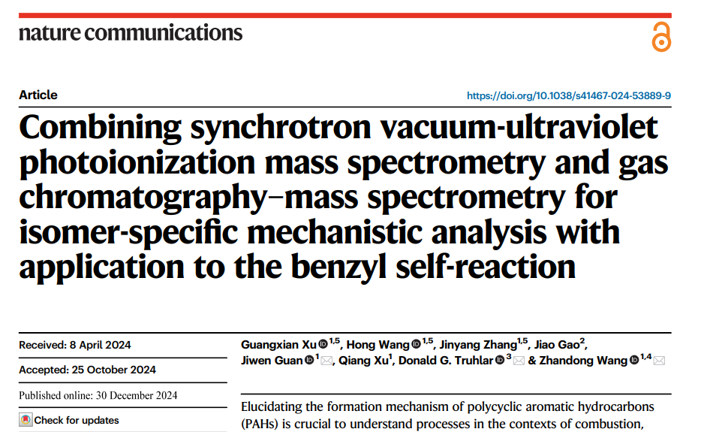
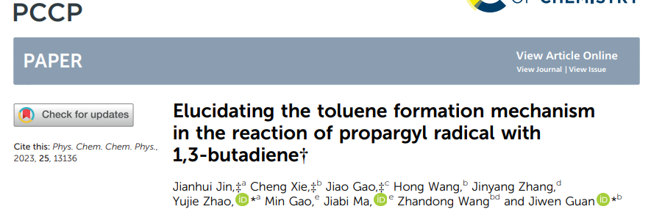
Free radical reaction and soot formation

Slide 13
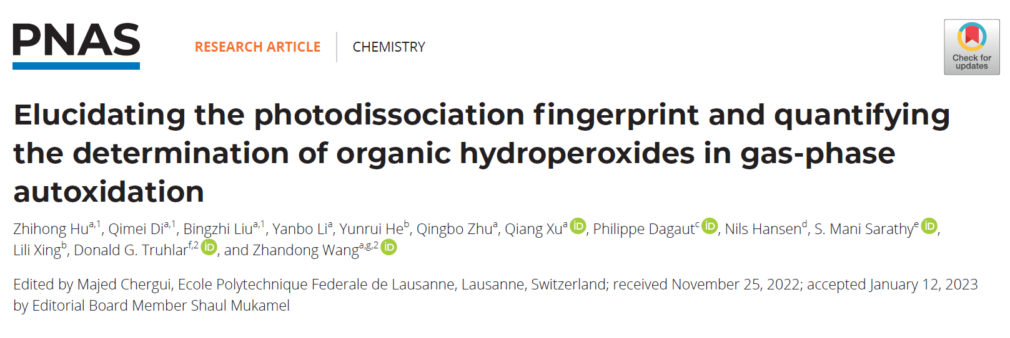
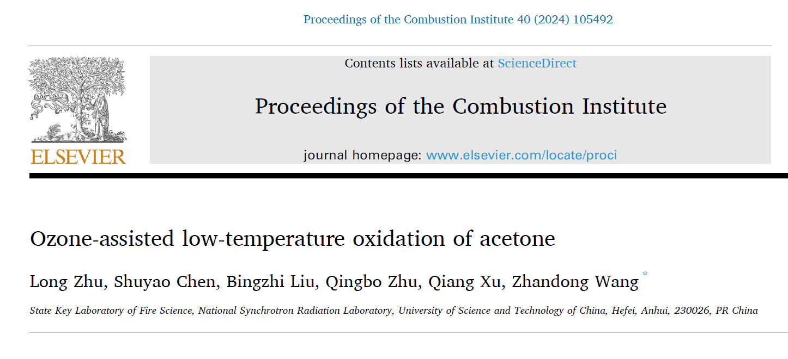
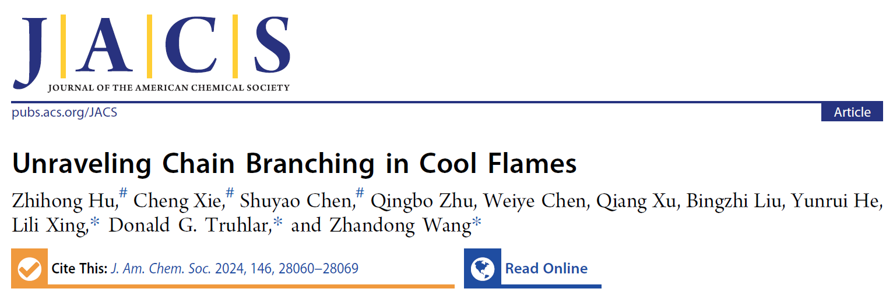
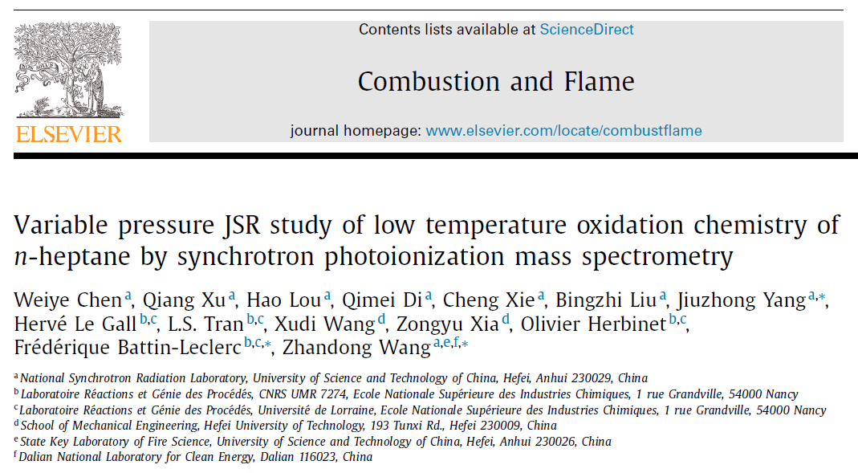
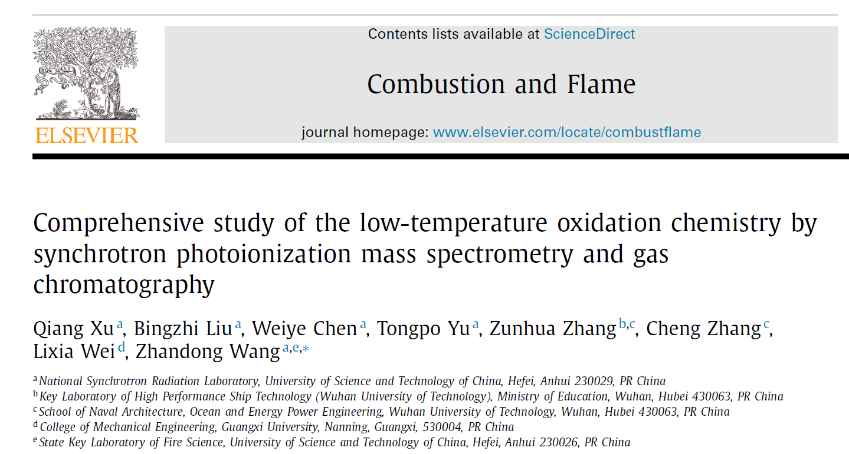
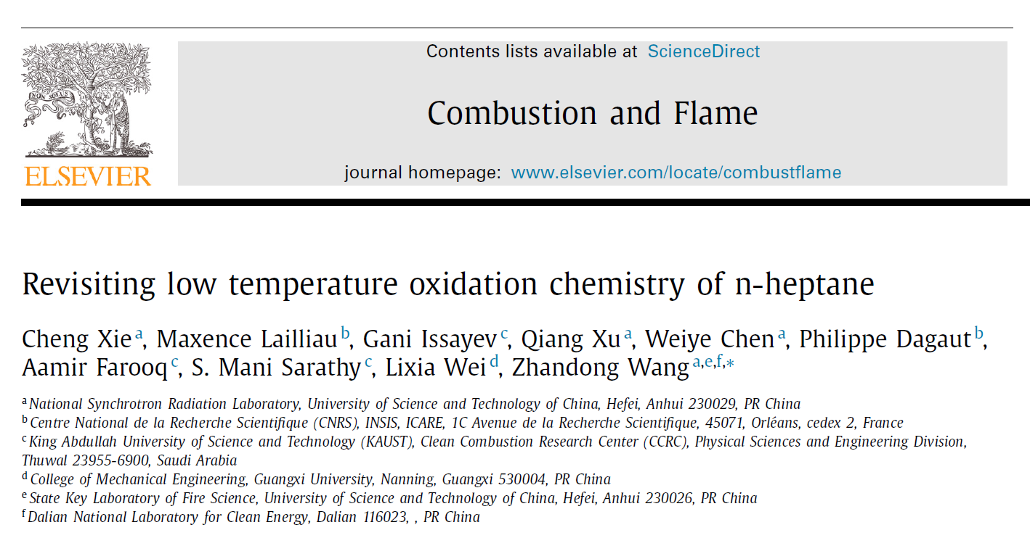
Low temperature oxidation chemistry

Slide 14
目录
CATALOG
01
02
03
04
Beamline
Methods
Examples
Beamtime

Slide 15

Beamtime apply
User login to the Chinese Academy of Sciences Major Scientific and Technological Infrastructure Sharing Service Platform (https://lssf.cas.cn), Register an account
Submit a project application (non-employed personnel are not allowed to apply)
User project review: Hefei Light Source accepts user project applications all year round and reviews them once a quarter
User beamtime application and usage process details： http://www.nsrl.ustc.edu.cn/2016/0425/c10980a124134/page.htm

Slide 16


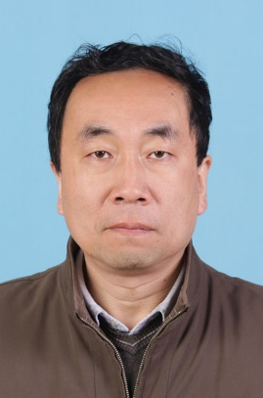
Contact us
Prof. Zhandong Wang
Group leader
0551-63602125
zhdwang@ustc.edu.cn
Dr. Jiwen Guan
Beamline scientist
15156078061
jguan43@ustc.edu.cn
Mr. Xiaobin Shan
Engineer
shanxb@ustc.edu.cn
Adequate early communication is conducive to the smooth progress of the project

Slide 17


谢谢
中国科学技书大学
国家同步辐射实验室

